Slide 1
Statistics for Linguists
AdamJ.R. Tallman
2023-01-31

Slide 2
From last lecture
logistic regression

Slide 3
For this lecture
Exploratory data analysis
Conditional inference trees
Random forests
Clustering
(e.g. hierarchical clustering)

Slide 4
Exploratory data analysis

Slide 5
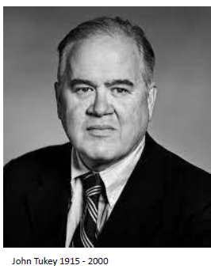
Exploratory data analysis
The basic idea of exploratory data analysis were pioneered and articulated by John Tukey.
Developed Fast Fourier transforms, Tukey’s test, Tukey’s lemma etc.
Developed methods for visualizing data in order to probe assumptions of statistica models or to look for unexpected patterns.
Invented boxplots and a number of other visual techniques we now use today.
Also invented the term ‘bit’

Slide 6
“The most important maxim for data analysts to heed, and one many statisticians seem to have shunned is this: “Far better an approximate answer to the right question, which is often vague, than an exact answer to the wrong question, which can always be madre more precise.” Data analysts must progress by approximate answers at best since its knowledge of what the problem really is will at best be approximate” (Tukey 1962: 62)

Slide 7
Exploratory data analysis
Some things that EDA is for ...
Guarding against erroneous conclusions from data
Looking at nonlinearity in the data (plotting techniques,should the data be logged, etc.?)
Advanced graphics (boxplots)
Model diagnostics (checking for heteroskedasticity, etc.)
Exploring the data to develop new hypotheses
EDA contrasts with CDA (confirmatory data análisis), or what I referred to as “Inferential statistics” earlier in the course
EDA is about iterative hypothesis generation through interaction with the data

Slide 8
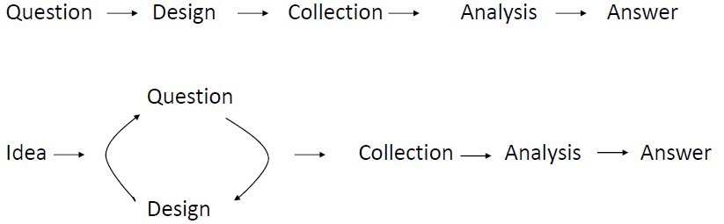
Exploratory data analysis
Straight line paradigm vs. iterative approach to development of ideas
Tukey (1980)
Exploratory data analysis is basically the detective work that goes on behind the scences of confirmatory data analysis

Slide 9
Algebra lies
Imagine a model as follows:
y = a + bx + e
Where a is 3 and b is 0.5
There are a variety of patterns that this could correspond to –

Slide 10
Algebra lies
Remember what this model assumes is (approximately) true:
residuals are evenly distributed around the mean
the relationship between x and y is a linear one
there is no heteroskedasticity
(that is the error increases/decreases at certain points in the relationship)
Notes:
Look up heteroskedasticity so you know what it is.

Slide 11
Algebra lies, so you need graphs
Data analysis is about summation or aggregation over data, but different ways of aggregating the data can provide different results.
Imagine x has a standard deviation of 3.3 and a mean of 9
Imagine y has a standard deviation of 2 and a mean of 7.5
For y = a + bx + e, a = 3, b =0.5
There are actually a lot of different patterns that can correspond to this statistical summation.

Slide 12
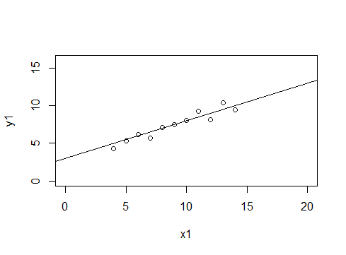
set.seed(3)
x1 <- seq(4,14,by=1)
y1 <- 3 + 0.5*x1+ rnorm(11,0,0.7)
plot(x1,y1, xlim=c(0,20), ylim=c(0,16))
abline(a=3, b = 0.5 )

Slide 13
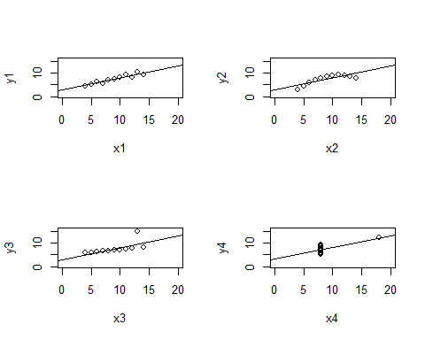
These will all give you roughly the same result for the slope and the intercept
but it is obvious that the model is only good for the first graph.
Slope = 0.5
Intercept = 3
The point is that without a visual exploration of the data and/or any attempt to test modelling assumptions, your model will make bad predictions.

Slide 14
Graphs lie, so you need algebra
It’s easy to give misleading figures – or its easy to give figures that deceive.
Governments and other institutional bodies with a vested interest in the public or stakeholders not knowing the truth of the situation are experts in this.

Slide 15

Don’t be a dupe
Lots of racist pseudo-scientific ideas use statistics (to this day)
The idea is to browbeat readers / the public into accepting certain ideologies.
More importantly, statistical models make assumptions, and couching those assumptions in math is a way of avoiding criticism.
Often the statistics are done poorly.
See Gould The mismeasure of man
Sometimes they are done “according to standards”, but the standards are bad.
See Clayton Bernouilli’s fallacy

Slide 16
UT Austin, tuition increases
UT Austin administration uses this graph to argue in favor of tuition increases to this day

Slide 17
UT Austin, tuition increase arguments
Here’s another (most honest) graph that we produced looking at the relationship between tuition revenue and state appropriations over time.

Slide 18
UT Austin, tuition increase arguments
Here’s how much actual public funding the university has from 2004-2013

Slide 19
Graphs lie, so you need algebra
Its also easy to deceive yourself with graphs, because the grapahing algorithm can do something to the data that you don’t expect.

Slide 20
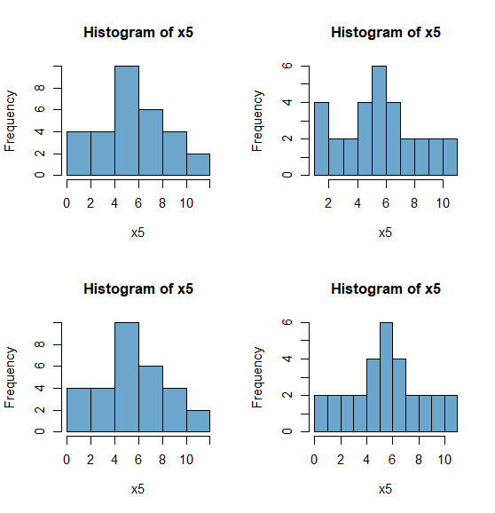
These are all from the same data, but setting the bins and bin spacing differently.
We know that only the last one is an accurate representation of the data.

Slide 21
Hiding structure
Certain types of graphs can also hide structure.
The boxplot is a graph based on a 5 number summary of the data.
The median, the first and second quartile and the lowest and highest numbers or something else separating extreme values (e.g. 5% /95% confidence intervals).
All graphical techniques hide certain aspects of structure, even boxplots

Slide 22
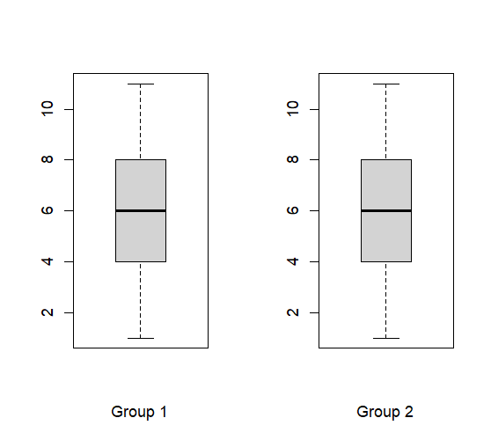
95% of data below this or Max
2nd quartile
Median
1st quartile
5% of data below this or Min

Slide 23
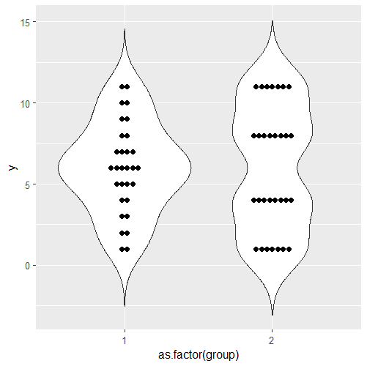
Dot plot
A dot plot (violin plot) might be more revealing in this case.

Slide 24
Conditional inference trees / Random forests

Slide 25
Conditional inference tree
A conditional inference tree is a combination of regression models that attempts to get the best fit by partitioning the data into biivariate models.
Example – say you are looking at “stress” with part of speech and duration as a correlates – the model might tell you – first split the data into function words and then into {verbs, nouns and adjectives}, then duration is a good predictor for the latter group, but less so for the former.
This sounds really complicated, but once its visualized it is actually fairly intuitive.

Slide 26
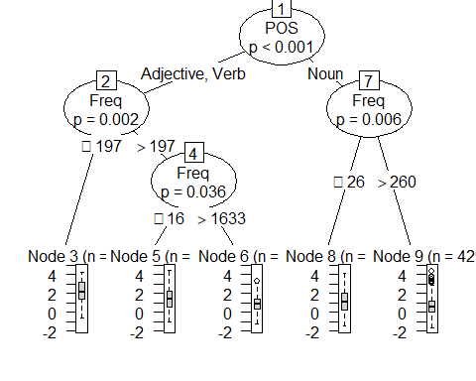
Notes:
Predicting iconicity from POS and frequency ...

Slide 27
Trees to forests
Conditional inference trees aren’t stable
Not stable: A tiny change in the sample can change the results,sometimes dramatically.
Random forests are a way of dealing with this instability.

Slide 28
Random forests
Samples different partitions of the data and develops n number of trees.
Aggregates over the results of the trees and provides various measurements of the relative importance of variables.

Slide 29
Conditional inference trees & random forests
let’s practice

Slide 30
Clustering

Slide 31
Clustering analysis
Clustering analysis falls under exploratory data analysis.
There is a quite a bit of literature on using validation techniques that have a sort of confirmatory / inferential goal – its basically a madhouse.
Clustering analysis is a type of machine learning.
When people talk about “algorithms” being used to market products, they are basically talking about some type of clustering analysis.

Slide 32
Clustering analysis
Why isn’t clustering inference?
There is no distinction between dependent and independent variable.
There’s no causal structure in the model
You just have a back of variables and you are using algorithms to classify them into groups.

Slide 33
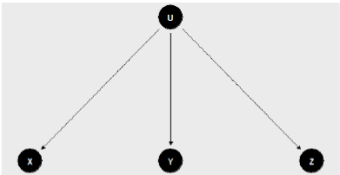
Clustering conceptualized causally
U is an unmeasured variable (assume its a factor)
Let us say that U is responsible for the patterns we find in X, Y and Z.
Can we figure out the value of U?

Slide 34
Clustering analysis
You can use various algorithms to group data points into groups according to their overall closeness with respect to a set of variables considered.
But there are a lot of different clustering algorithms
Why?

Slide 35
Problems with clustering
Cluster has no meaning: There “is not a standard or even useful definition of the term “cluster”, and many have argued that it is either too late or irrelevant to create one”
(Aldenderfer & Blashfield 1984: 33)
Clustering tendency problem: “the problem of deciding whether data exhibit a predisposition to cluster into natural groups without identifying the groups themselves. Clustering algorithms will create clusters whether the data are naturally clustered or purely random”
(Jain & Dubes 1988: 201)

Slide 36
Cluster has no definition
Clusters are calculated based on some measurement of dissimilarity between data points.
Representation of some definition of intercluster dissimilatory; (a) Group average; (b) Nearest neighbor; (c) Further neighbor
from Kaufman 1980: 47

Slide 37
Cluster has no definition
Types of clusters
(a) Ball shapes
(b) elongated
(c) compact but not well seperated

Slide 38
Clustering algorithms
As EDA, clustering is well-known to be a useful tool, but as CDA

